Slide 1
Big Data Analytics Unit 6: Introduction to Cassandra
Prof.P.R.Gadekar
SKN Sinhgad College of Engineering,Pandharpur

Slide 2
Syllabus of Unit-6 :Introduction to Cassandra
Features of Cassandra,
CQLSH - CRUD,
Collections,
Counter,
List,
Set,
Map,
Tracing.

Slide 3
Introduction to Cassandra
“Data is a precious thing and will last longer than the systems themselves.” – Tim Berners-Lee, inventor of the World Wide Web.

Slide 4
APACHE CASSANDRA – AN INTRODUCTION
1. Apache Cassandra was born at Facebook.
After Facebook open sourced the code in 2008, Cassandra became an Apache Incubator project in 2009 and subsequently became a top-level Apache project in 2010.
2. It is built on Amazon’s dynamo and Google’s BigTable.

Slide 5
3. Cassandra does NOT compromise on availability.
Since it does not have a master-slave architecture, there is no question of single point of failure.
This proves beneficial for business critical applications that need to be up and running always and cannot afford to go down ever

Slide 6
5. It is a column-oriented database designed to support peer-to-peer symmetric nodes instead of the master-slave architecture.
6. It has adherence to the Availability and Partition Tolerance properties of CAP theorem. It takes care of consistency using BASE (Basically Available Soft State Eventual Consistency) approach.

Slide 7
Refer Figure 7.1.
Few companies that have successfully deployed Cassandra and have benefitted immensely from it are as follows:
1. Twitter
2. Netflix
3. Cisco
4. Adobe
5. eBay
6. Rackspace

Slide 8
Features of Cassandra
Following are the features of Cassandra
Peer-to-Peer Network
Gossip and Failure Detection
Partitioner
Replication Factor
Anti-Entropy and Read Repair
Writes in Cassandra
Hinted Handoffs
Tunable Consistency: Read Consistency and Write Consistency

Slide 9
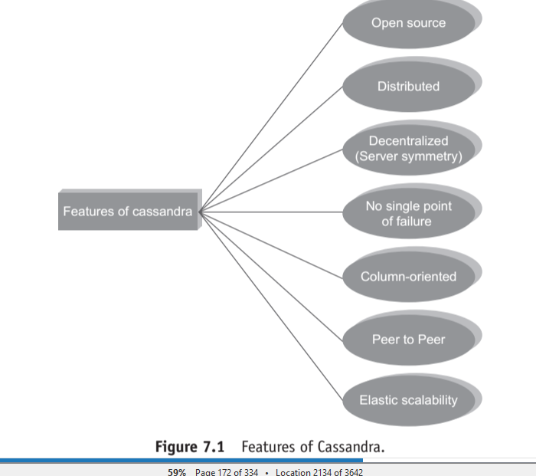

Slide 10
Peer to Peer Network
Cassandra does NOT have a master-slave architecture which means that it does NOT have single point of failure.
A node in Cassandra is structurally identical to any other node. Refer Figure 7.2.

Slide 11
It tides over the problem of failure by employing a peer-to-peer distributed system across homogeneous nodes.
It ensures that data is distributed across all nodes in the cluster. Each node exchanges information across the cluster every second.

Slide 12
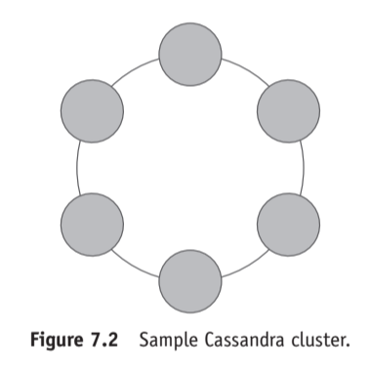

Slide 13
Gossip and Failure Detection
Gossip protocol is used for intra-ring communication.
It is a peer-to-peer communication protocol which eases the discovery and sharing of location and state information with other nodes in the cluster.
Ref .Fig.7.3

Slide 14
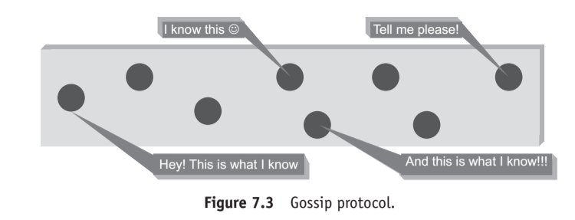

Slide 15
A node only has to send out the communication to a subset of other nodes.
For repairing unread data, Cassandra uses what’s called an anti-entropy version of the gossip protocol.

Slide 16
Partitioner
A partitioner takes a call on how to distribute data on the various nodes in a cluster.
It also determines the node on which to place the very first copy of the data.

Slide 17
Replication Factor
The replication factor determines the number of copies of data (replicas) that will be stored across nodes in a cluster.
Two replication strategies are available:
1. SimpleStrategy.
2. NetworkToplogyStrategy.

Slide 18
Anti-Entropy and Read Repair
A cluster is made up of several nodes.
Since the cluster is constituted of commodity hardware, it is prone to failure.
In order to achieve fault tolerance, a given piece of data is replicated on one or more nodes.

Slide 19
A client For repairing unread data, Cassandra uses an anti-entropy version of the gossip protocol.
Anti-entropy implies comparing all the replicas of each piece of data and updating each replica to the newest version.

Slide 20
Writes in Cassandra
Here is a client that initiates a write request.
Where does his write get written to?
It is first written to the commit log.

Slide 21
A write is taken as successful only if it is written to the commit log.
The next step is to push the write to a memory resident data structure called Memtable.
The memtable stores writes in a sorted order until reaching a configurable limit and then it is flushed.

Slide 22
Hinted Handoffs
Why Cassandra is all for availability? It works on the philosophy that it will always be available for writes.
Assume that we have a cluster of three nodes – Node A, Node B, and Node C. Node C is down for some reason. Refer Figure 7.4.

Slide 23
We are maintaining a replication factor of 2 which implies that two copies of each row will be stored on two different nodes.
The client makes a write request to Node A.
Node A is the coordinator and serves as a proxy between the client and the nodes on which the replica is to be placed.

Slide 24
The client writes Row K to Node A.
Node A then writes Row K to Node B and stores a hint for Node C.
The hint will have the following information:
1. Location of the node on which the replica is to be placed.
2. Version metadata. 3. The actual data

Slide 25
. When Node C recovers and is back to the functional self, Node A reacts to the hint by forwarding the data to Node C.

Slide 26
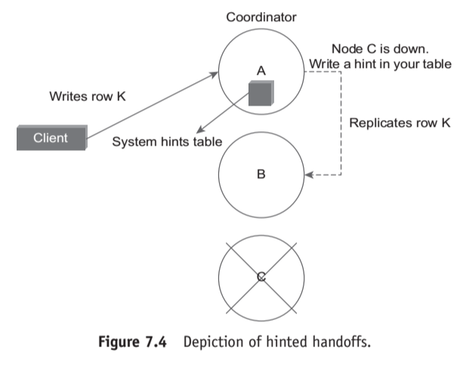

Slide 27
Tunable Consistency
One of the features of Cassandra that has made it immensely popular is its ability to utilize tunable consistency.
The database systems can go for either strong consistency or eventual consistency.
Cassandra can cash in on either flavor of consistency depending on the requirements.

Slide 28
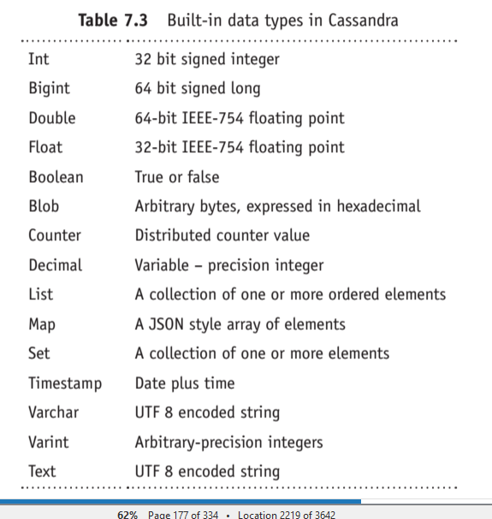
CQL Data Types

Slide 29
CQLSH
Cassandra Query Language Shell (CQLSH) is basically a communication medium between Cassandra and the user.
CQLSH is a platform that allows the user to launch the Cassandra query language (CQL).
The user can perform many operations using cqlsh.

Slide 30
Some of them include: defining a schema, inserting and altering data, executing a query etc..
It basically is a coding platform for Cassandra.
Hence, a user can program Cassandra to work according to his requirement.

Slide 31
CRUD (CREATE, READ, UPDATE, AND DELETE) OPERATIONS
Objective:
To insert data into the column family “student_info”.
An insert writes one or more columns to a record in Cassandra table atomically. An insert statement does not return an output.

Slide 32
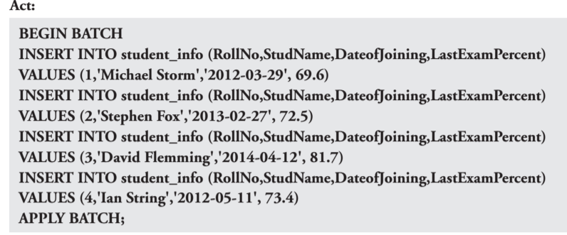

Slide 33
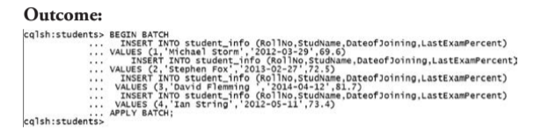

Slide 34
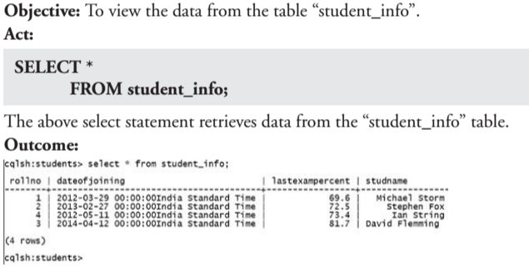

Slide 35
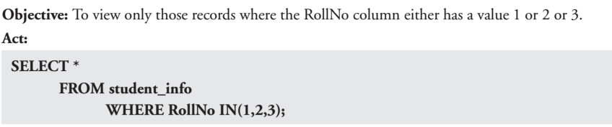

Slide 36
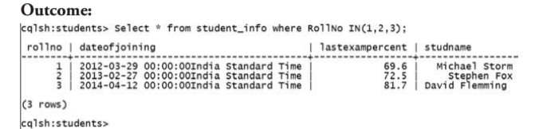

Slide 37
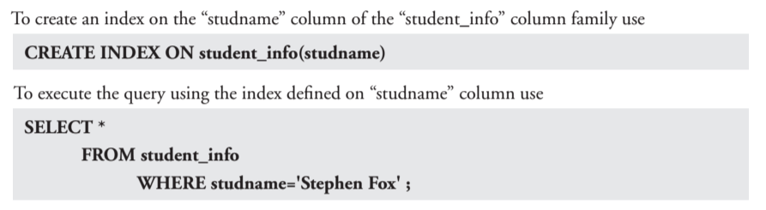

Slide 38
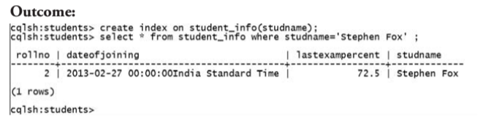

Slide 39
Objective:
Let us create another index on the “LastExamPercent” column of the “student_info” column family.

Slide 40
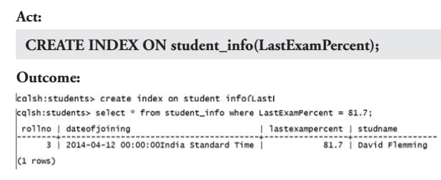

Slide 41
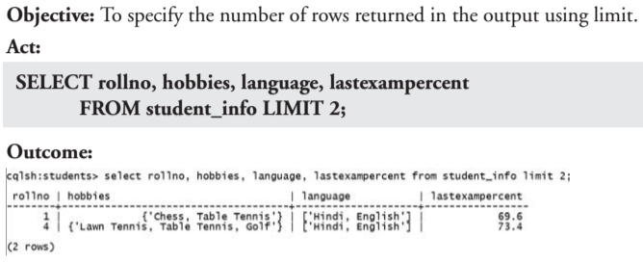

Slide 42
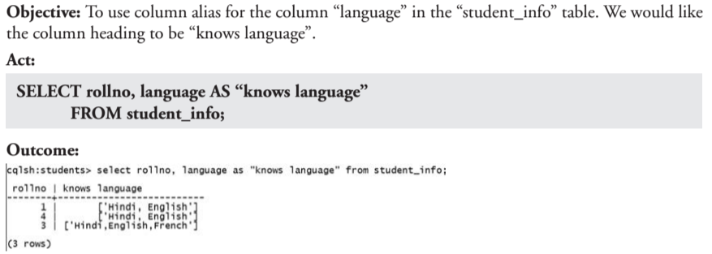

Slide 43
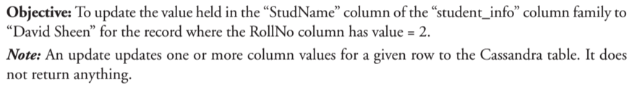

Slide 44
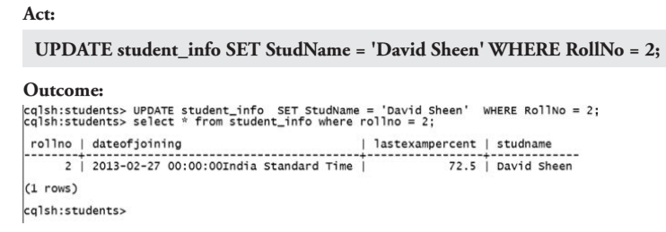

Slide 45
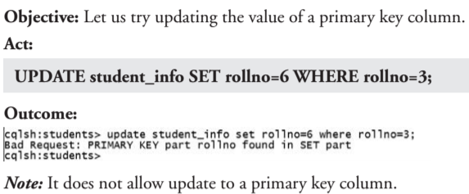

Slide 46
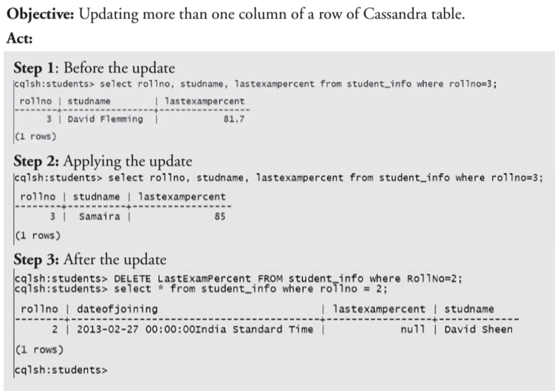

Slide 47
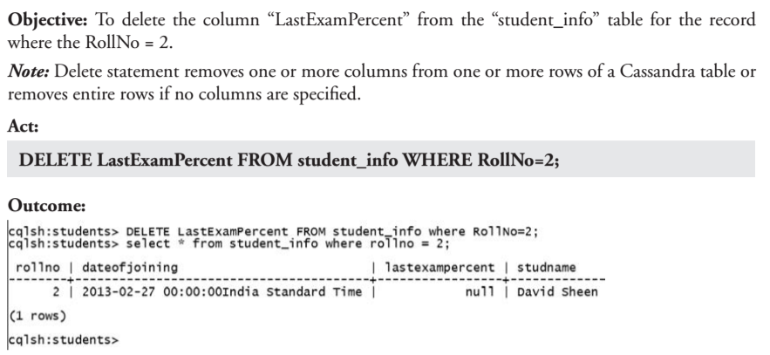

Slide 48
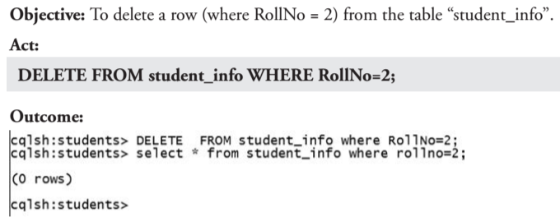

Slide 49
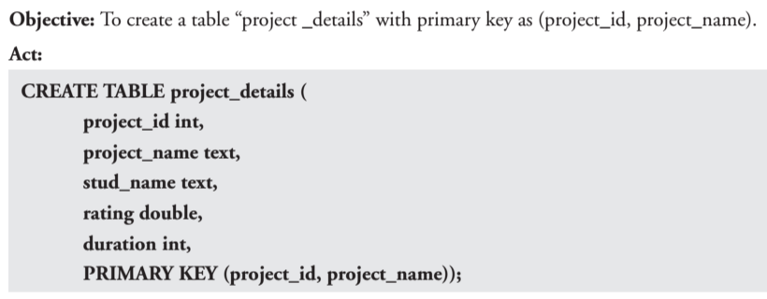

Slide 50
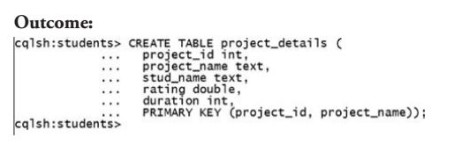

Slide 51
COLLECTIONS
1.Set Collection
2.List Collection
3.Map Collection

Slide 52
7 COLLECTIONS
1.Set Collection
A column of type set consists of unordered unique values.
However, when the column is queried, it returns the values in sorted order.
For example, for text values, it sorts in alphabetical order.

Slide 53
2.List Collection
When the order of elements matter, one should go for a list collection.
For example, when you store the preferences of places to visit by a user, you would like to respect his preferences and retrieve the values in the order in which he has entered rather than in sorted order.
A list also allows one to store the same value multiple times.

Slide 54
3. Map Collection
As the name implies, a map is used to map one thing to another. A map is a pair of typed values. It is used to store timestamp related information. Each element of the map is stored as a Cassandra column. Each element can be individually queried, modified, and deleted.

